Slide 1
Optimization of underground garbage containers
Corné Heijnen (12230170)

Slide 2
Relevance, research gap and research question
Garbage recycling in Amsterdam one of the worst municipalities in the Netherlands
20% vs almost 95% in best cities
Centralized garbage containers for different fractions to stimulate recycling
Configuration of these containers is currently done manually
Computational solution may have added value
Due to large solution space, no exact solution can be given → approximation algorithms
To what extent can different computational algorithms combined with (meta-) heuristics be used to optimize the configuration of underground garbage containers in the City of Amsterdam?

Slide 3
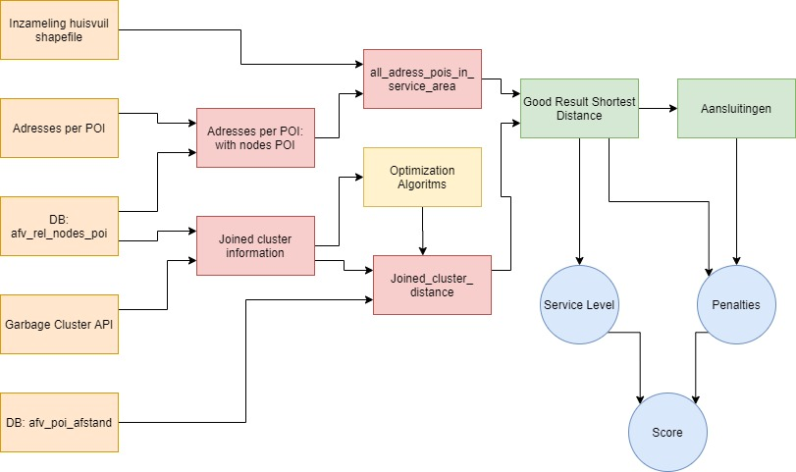
Methodology
5 different data sources
Combinining
Cleaning
Baseline setting
Algorithms for modificiations
Picking best solution
Visualisation of result

Slide 4
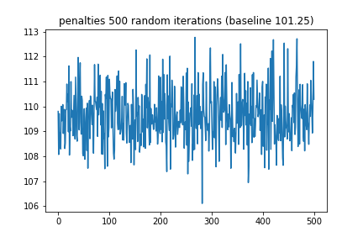
Preliminary results
Notes:
The baseline score of 101.25 can not be lowered by using a purely ‘naive’ random algorithm that just reorders all exisiting containers. The use of iterative algorithms, general metaheuristics and problem-specific heuristics is needed to tackle this problem.

Slide 5
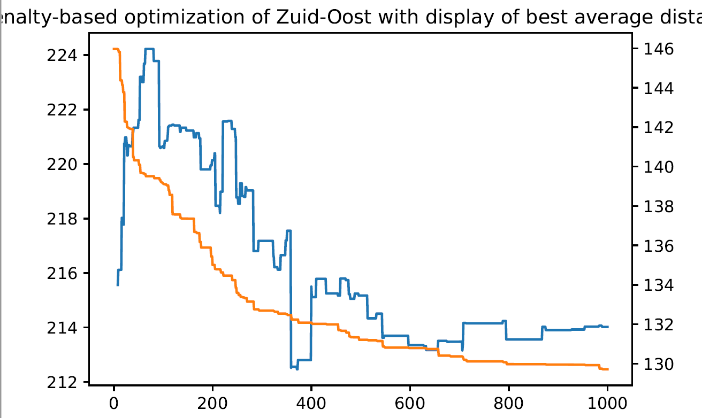
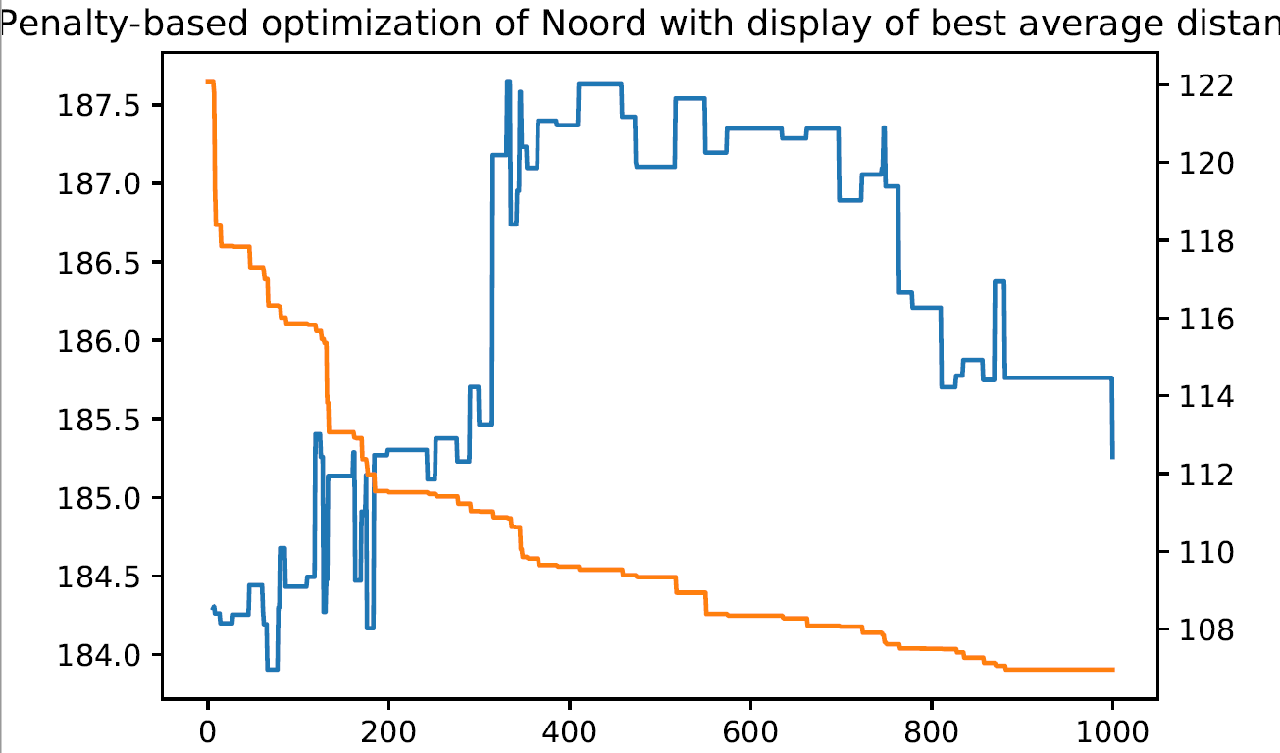
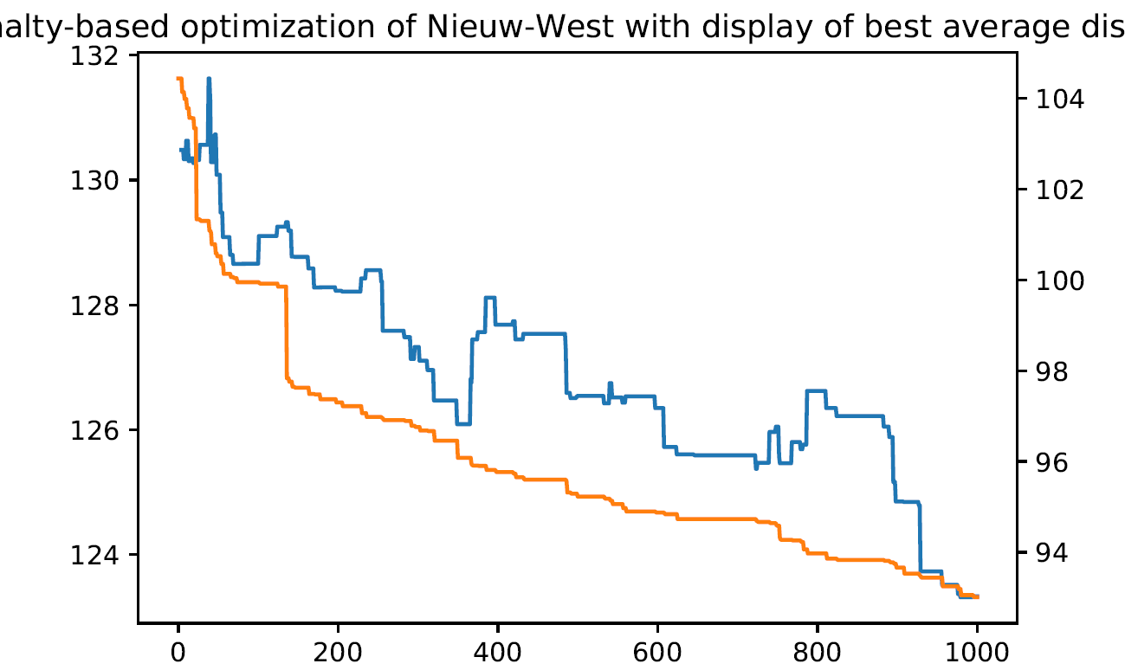
Preliminary Results
Correlation between walking distance (blue) and penalties (orange) different per subcluster
Optimization in subclusters and with problem-specific constraints speeds up optimization both in computational times as well as in number of iterations
Combining these subclusters for final result

Slide 6
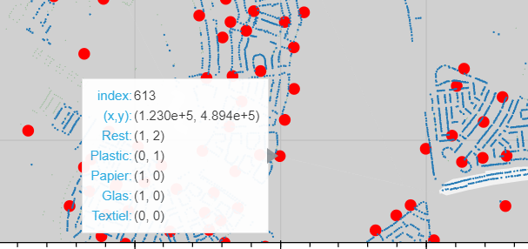
Preliminary Results
Notes:
Screenshot of the interactive Bokeh plot showing the old and new configuration of one of the garbage container clusters.

Slide 7
Remaining work and plan
Further optimization of other subclusters (Centrum and returning total score)
Testing of additional heuristics and metaheuristics to further boost the total score
Re-evaluating the weights of different parameters
Setting up visualisation as a usable tool for decision making

Slide 8
Strengths and limitations of research
Initial research appear to be hopeful for positive outcomes
similar approach has never been done for these type of problems
Positive outcome makes huge impact on environmental and financial issues
Methodology can be transferred to other usables and municaplities
Quantifying service level tends to be difficult
Multiple constraints and limitations not included in final product yet
Validity of superior outcome is hard to measure and takes lot of user input

